Slide 1
Chamber 5.0

Slide 2
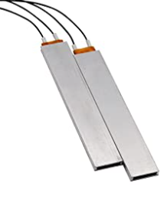
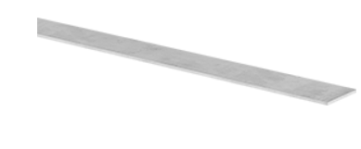
Materials
Heating element (20x80mm): https://www.amazon.com/MODUODUO-Thermistor-Temperature-Thermostat-Black-12V/dp/B0B8MM4TXJ/ref=psdc_516188_t5_B09YLRMRF6?th=1
Aluminum sheet (2x25x1ft): https://www.mcmaster.com/9146T16/

Slide 3
Magnetic pressure plate
Can it produce enough force to seal chamber?
Results
Using ¼ thick below and 1/8 in upper plate, not enough force
2. slide+chamber = 3.5mm thick, riser height = 2.2. Magnet resin gap = 1.3mm, magnet magnet gap =3.2mm
3. If mag-resin = 0.3 and net mag mag gap = 1.5mm, then mag force = 4.4 times higher

Slide 4
Building
Don’t install magnets for PP before potting epoxy added.
Add film of FEP tape over rows with magnets
Add epoxy and press with FEP plate
Clamp FEP plate and sit for 24hrs.
Remove plate and tape
Add in pp magnets and seal top with plastiweld and FEP film to form lid

Slide 6
Encasement testing
Liquid UV resin can be cured strongly to UV resin fully cured items.
Will UV resin cure to PLA strongly?
Is strength enough for encasement?
Appears to give enough for encasement, but lacks bonding strength for anything structural

